Slide 1
Reducing Q3 Sales Decline Through Customer and Product Insights
AO minimarket

Slide 2
What is happening?
Situation
Complication
The retailer generated ₱456,000 in sales across 1,000 transactions and 2,514 units sold during 2023. Electronics was the highest revenue-generating category, while customers aged 25-54 contributed the largest share of spending.
Despite strong annual performance, sales fell significantly in Q3 to ₱96,045, making it the weakest quarter of the year. The decline affected all product categories and reduced overall business performance.

Slide 3
What is happening?
Question
Answer
How can the retailer reduce the Q3 sales decline and maintain more consistent revenue throughout the year?
The retailer should leverage its strongest revenue drivers, specifically Electronics and customers aged 25-54, through targeted seasonal promotions and customer-focused campaigns during Q3.

Slide 4
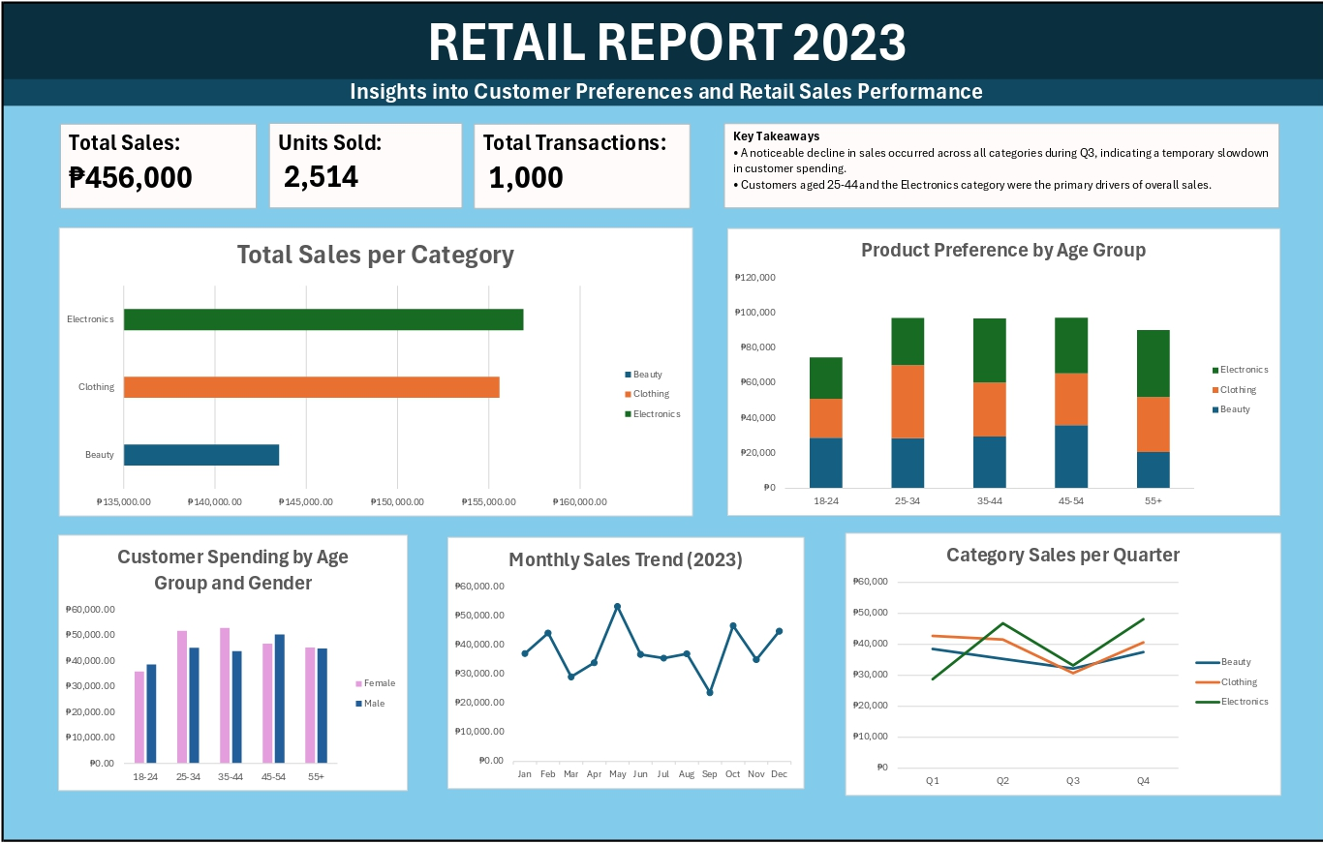

Slide 5
Electronics Is the Strongest Revenue Driver and a Key Lever for Growth

Slide 6
Customers Aged 25-54 Drive Most Retail Revenue

Slide 7
Gender Spending Differences Create Opportunities for Targeted Promotions

Slide 8
Sales Momentum Weakened During Q3 Before Recovering in Q4

Slide 9
Q3 Sales Slowdown Impacts All Categories Before Strong Q4 Recovery

Slide 10
Recommendations
Increase Q3 sales through Electronics bundle promotions targeted at high-value customers aged 25-54.
Improve promotional effectiveness through age- and gender-based customer segmentation campaigns.

